Slide 1


OPTIMIZATION OF MEDICAL INVENTORY.
Tools : Python , My SQL
📂 Overview
This project showcase on a typical time series forecasting pipeline, consisting of three major phases:
Feature engineering and Data preparation
Exploratory data analysis (time-series analysis)
Forecasting

Slide 2
Contents
Business Objective
Business Constraints
Project Architecture
Data Collection
Exploratory Data Analysis
Data Visualization
Notes:
Change

Slide 3
Business Problem
Minimize the bounce rate
Minimize the inventory cost

Slide 4
Project Overview and Scope
Development of a pharmaceutical(medicine) forecasting model aims to mitigate the potential to minimize the bounce rate. Its business constraints is also that to minimize inventory cost,It includes collecting historical sales data and analyzing it to identify patterns and trends in drug demand. Based on the analysis of the data, we developed a forecasting model that predicts the demand for medical supplies. The project will involve collecting data on the inventory levels, usage patterns, and other relevant factors. This data will be analyzed to identify trends and patterns in supply and demand.

Slide 5
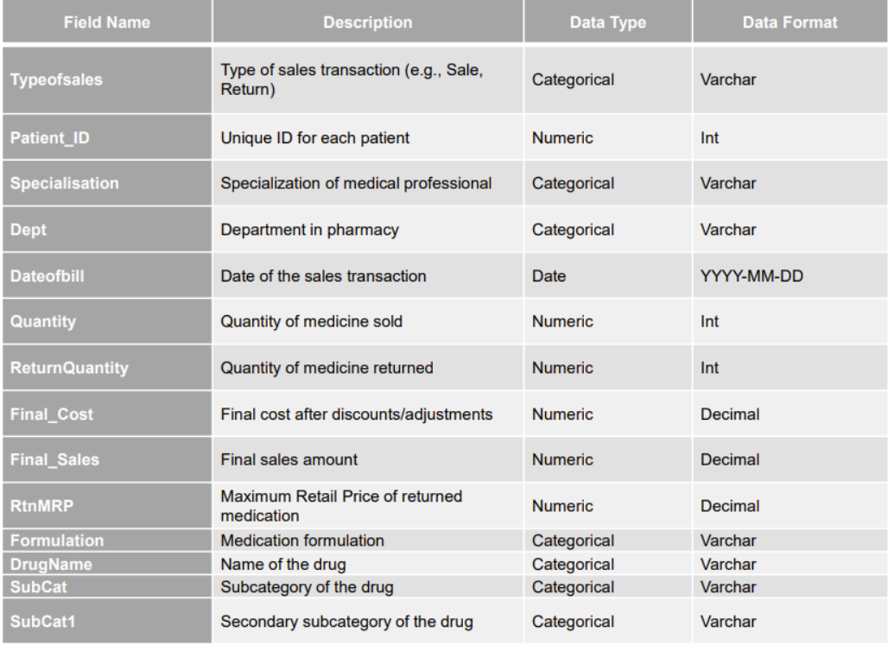
Data Dictionary

Slide 6
Exploratory Data Analysis [EDA]
Statistical Insights
Business Insights
The results indicate that the unclean data exhibits higher mean, variance, standard deviation, range, skewness, and kurtosis values compared to the clean data. This suggests greater inconsistencies, variability, and potential outliers in the unclean data. Cleaning the data has resulted in more stable and normalized distributions with reduced variability and potential biases, making it more reliable for business decision-making.
We can observe that the data exhibits higher range, variance, standard deviation, skewness, kurtosis, and lower mean.
We could also observe the presence of redundancy in the data which also affects the distribution of the data.
Numerical data fields have higher variance than that of categorical fields. It implies that continuous fields like Quantity, ReturnQuantity, RtnMRP, Final_Cost, Final_Sales are dependent and have higher variance.
With all the research and business understanding, it has been found that in December, sales and returns are high than in any other month. So, maintaining reasonable stock of drugs ranging between 3000 to 3200 is advised. Since MULTIPLE ELECTROLYTE 500ML IVF4608 and SODIUM CHLORIDE IVF 100ML 2774 are frequently sold out, checking these is also crucial. If we analyse the least sold drugs like SODIUM BICARBONATE 5.5 INJ, we can minimize bounce rate. Moreover, this can only be confirmed by proper analysis over a period, so that the bounce rate is reduced even more and ultimately satisfy the business constraints and achieve success criteria.
Notes:
EDA is used for seeing what the data can tell us before the modeling task.
Change

Slide 7
Data Preprocessing
Before cleaning and pre-processing the data,
The information of the records are :
Total Rows – 14218
Total Columns – 14
From the data provided the numerical columns are Patient_ID, Quantity, ReturnQuantity, Final_Cost, Final_Sales and RtnMRP from where the mean, median,mode,variance,std-deviation,skewness,kurtosis.
Initially the values and the count of the number of the rows were different i.e.,
After the data preprocessing the values of the mean, max and min values and the count of the number of rows have changed according removing all the duplicates as well as handling the missing values.
Total Rows | 14,218
Most Frequent | Sale
Frequency | 12537
Minimum | 4
Average | 4.24
Maximum | 6
Standard deviation | 0.65
Notes:
Keep observations

Slide 8
There were some missing values in the data in Quantity, ReturnQuantity, Final_Cost, Final_Sales and RtnMRP . This has been handled and has been adjusted by the most repeated values by doing the recursive function.
Total Rows | 14192
Min | 0
25% | 3548
50% | 7102
75% | 10657
Max | 14217
Mean | 7103
Medain | 7102
Standard Deviation | 4103
There were some missing values which has kept as unknown, and some duplicates which has been dropped for the efficient data. There were outliers in the numerical data which has to be adjusted by the regular capping method using the IQR with the tail and head cutoff where it starts from 25% to 75% and the extreme values are being replaced by the most repeated ones.

Slide 9
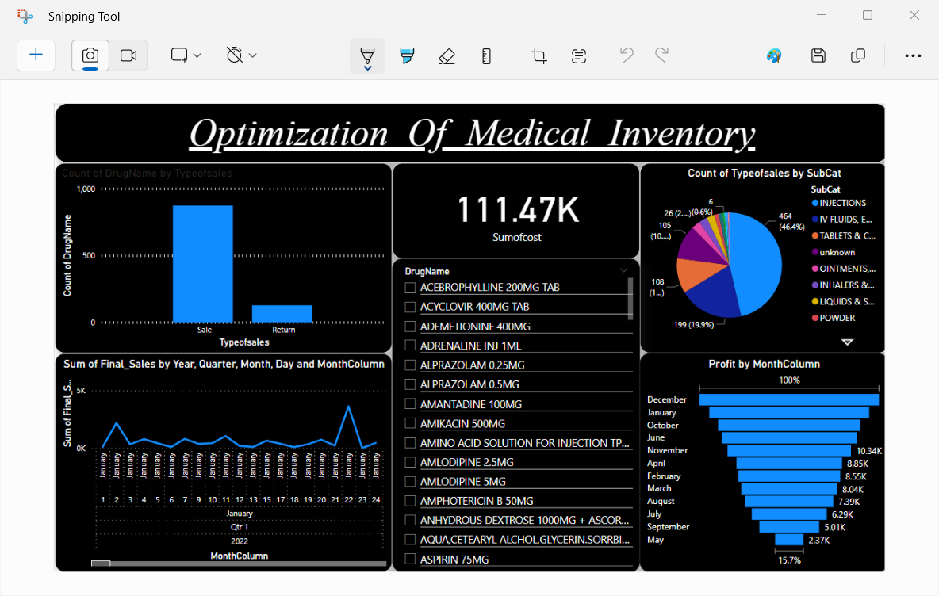
Data Visualization
Notes:
Add graphical

Slide 10
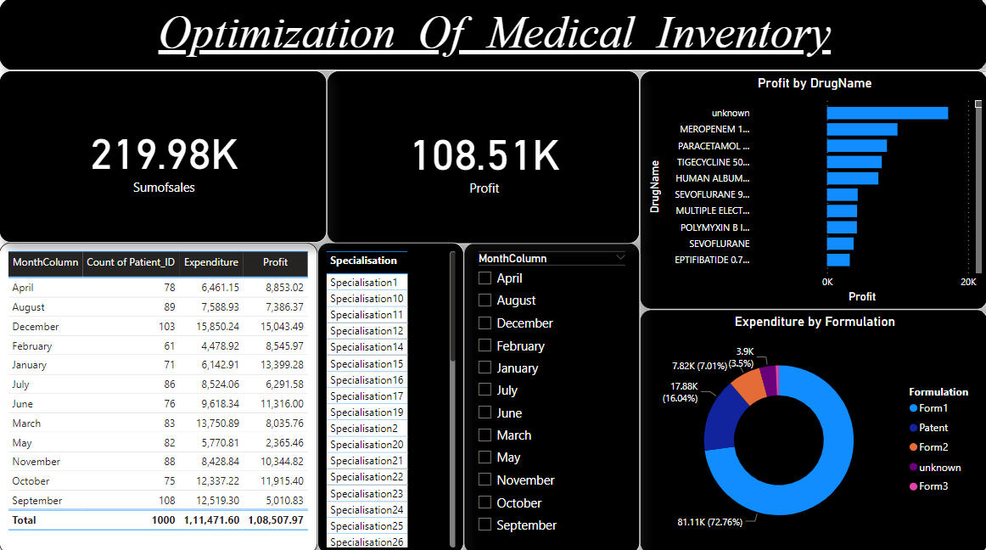
Data Visualisation

Slide 11


